Slide 1
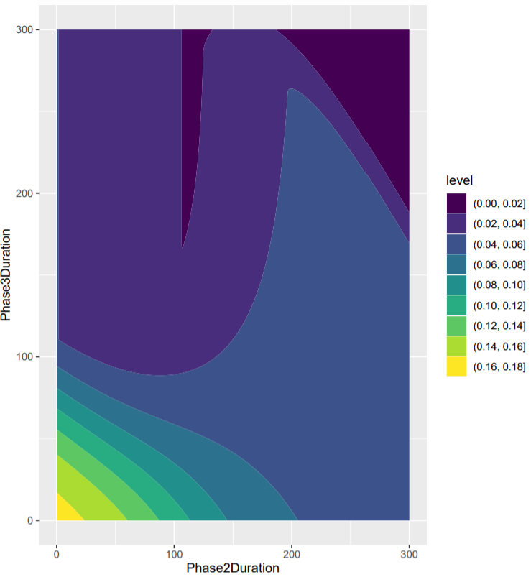
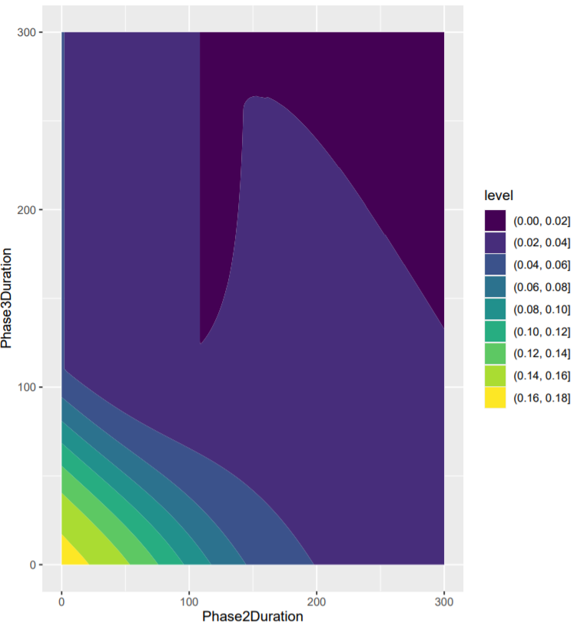
Optimising Phase 2 and 3 Duration
This colour represents most regions which have a max peak which fall under the Iv(t) = 0.0182
Phase 2 (Beta1 = 0.064)
Phase 2 (Beta1 = 0.032)
Phase 2 (Beta1 = 0)
R crashed running this last night

